Slide 1
Brian Locke ASPIRE Presentation

Slide 2
What I’m All About:
Comp Sci. Dorks like systems.
Initially: believer in the IHI / Evidence-Practice gap: If we could just get people to do the right (known) thing, we’d drastically improve care
Overton window: range of policies acceptable to the population
-> Exchange policies w process improvements: In healthcare, there is a narrow Overton Window of improvements one can make to improve care: ie. Sepsis 30cc/kg
Drive to research: I’m interested in how we know what to do for each patient: how can we move the window? Start w “Clinical Epidemiology”?
How do we predict what will happen to a patient? Diagnose+Data
How to do this? Think more sharply, collect and analyze data better.

Slide 3
Why Hypercapnia:
Presenting my framing here not because the data is new, but I’m curious if y’all agree with the framework as I propose it:
Why Hypercapnic Respiratory Failure?
80,000 hours argument

Slide 4
Syndromes; Nosology
Is this the right approach? Studying Hypercap RF vs Each cause.
Several underwhelming records: we still don’t really know what to do for sepsis; ARDs is slightly better but not clear benefits are specific to that group
Not diseases
Benefit of syndromes: easily clinically recognizable: think improvements in Sepsis quality of care.
Bad for: identifying who will benefit from a given intervention – as patients presumably respond to diseases based on their physiologic state (ie. interventions have their effect by changing physiology: this is modern medicines ‘cosmology’). – key is to identify prognostic features; relative effect modifiers
Promise is in phenotyping – breaking down the syndromes into subsets with predictable responses / implications, presumably based on physiology. Maybe it corresponds to current diagnosis, maybe other info (? For hypercap: maybe it has to do with cant vs wont breathe, or markers of control system stability vs respiratory frailty; the PIRO model (predisposition, insult, response, organ dysfunction)
Notes:
https://www.nature.com/articles/s41591-022-01843-x#Fig1 –
Argue to separate syndromes into:
Insult that can possibly lead to the syndrome: what is the physiologic disturbance?
Treatable trait: physiology identifiable by biomarkers (or other identifiable features) that predicts response to treatmen
Requires trials that enroll on the basis of treatable traits.

Slide 5
Goal: identify everyone who fits the syndrome of Hypercapnic RF – so that we can begin this process.
Why do this? I think our current definitions – E.g. OHS – miss a lot of people who share physiologic barriers.

Slide 6
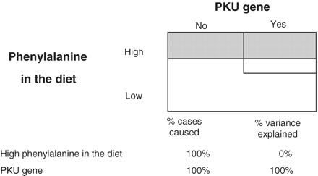
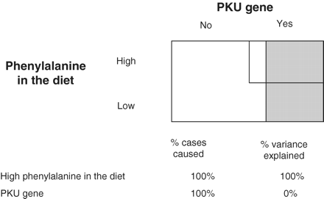
Critique of the Sufficient-Component Model
Consider PKU: Genetic defect causes disease when phenylalinine consumed.
-> in practice, everyone eats phenylalinine: genetic attributable fraction = 100%
-> however, modification of diet avoids development. Thus, if phenylalanine consumption varies then environment contributes
Consider, the hypothetical world where everyone has the PKU gene, but phenylalanine varies (lower diagram) – then, the disease is ALL environmental.
what is the relationship to mendelian randomization?
-> population attributable fraction (and percent variance explained) is not generalizable, and changes as covariates change. Applied to Hypercapnia?
Notes:
https://academic.oup.com/ije/article/40/2/503/733329
“These three examples, one of which approximates the real situation on planet earth and two of which are hypothetical, illustrate that the amount of population variation due to a particular factor can vary wildly between populations (or planets), even though it is an equally important cause in each situation. Once again, the proportion of population variation explained is not generalizable, and is not a valid effect measure”

Slide 7
Consider this as a missing data problem? What is the propensity of p(ABG)?
Could P(ABG) – by provider ideall (or institution) work as an instrument? (to wiggle the likelihood of a diagnosis… could you test that? Are high p(ABG) environments or providers more likely to apply the diagnosis?
[ ] casual inference podcast on instrumental variables.

